Slide 1





Is your friend lonely?...
Peter
….Then swipe right for love

Slide 2
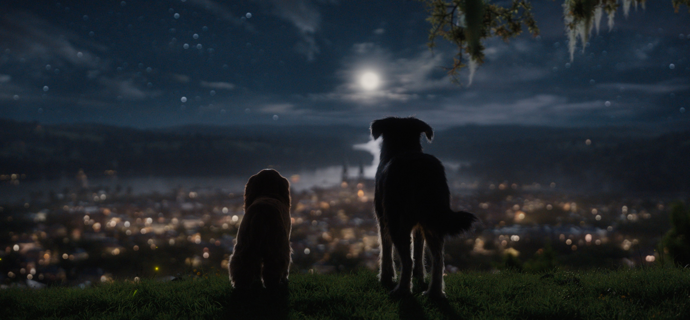
Is your friend lonely?....
…Is he or she looking for love?...
…Then help him find it!

Slide 3
Index.html
About
Sign in
Log in
Is your friend lonely?....
Is he or she looking for love?...
Then help him find it!

Slide 4
Sign_in.html
About
Log in
Sign in
Email address
Password
Sign in

Slide 5
Log_in.html
About
Sign in
Log in
Email address
Password
Log in

Slide 6
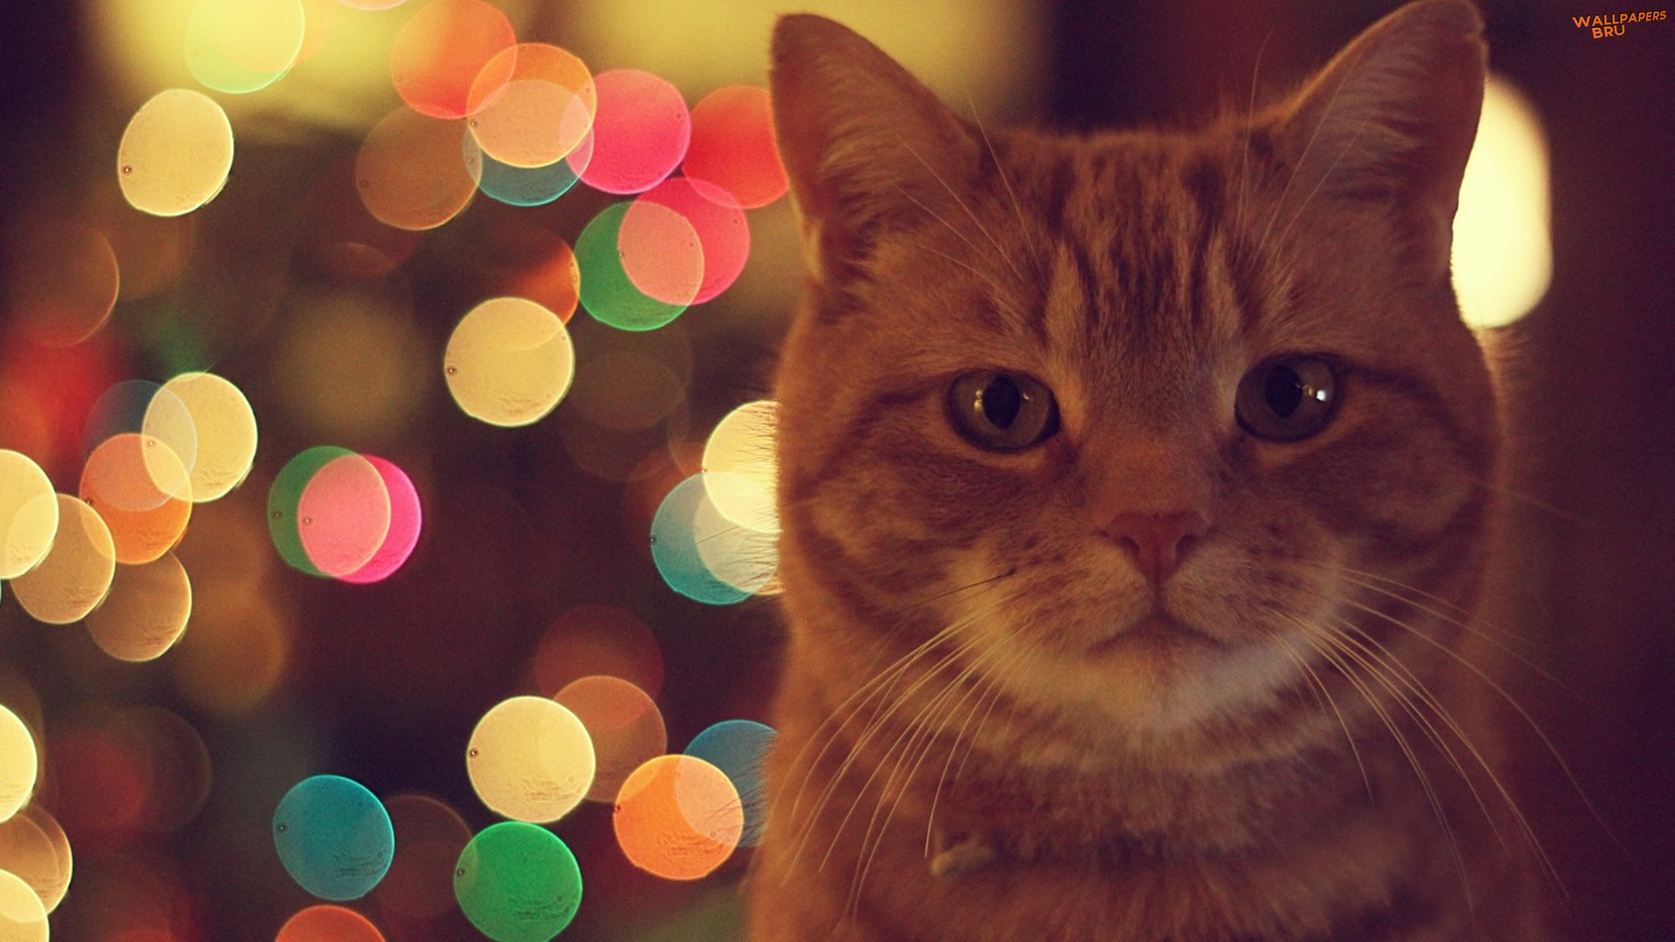
About
Peter

Slide 7
Home
Sign in
Log in
About

Slide 8

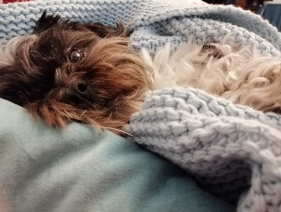
Who I am?
I am a 20 years old Computer Student in love with animals and Computer Science.
How was it born?
My brother’s Shih Tzu was having tough times finding a suitable mate, so I came with the idea of creating a platform where people’s pets could interact with each other the way humans do on dating sites.
How does it work?
1. Make a profile
Exemplu Match

Slide 9

Account
Explore
Profile
Sign Out
Who I am?
I am a 20 years old Computer Student in love with animals and Computer Science

